Slide 1
Journey at 2021 Wells Fargo Data Science Camp
June 2021

Slide 2
Overview of the two weeks journey
Platform Set-up (Google Colab)
Style Transfer Example (optional)

Slide 3
Two weeks journey
Day | Week 1 | Week 2
Monday | Intro to Data Science/ Motivating examples for each session/Set-up in Google Colab | 2nd NLP session and Transformer
Tuesday | Python Programming/Q&A for Google Colab Set-up | Reinforcement learning (RL)
Wednesday | Intro to Models (Linear Models, Random Numbers and Distributions) | GAN – Image Manipulation
Thursday | Neural Networks | Preparation to AI Startup Team Project and Team Neural Network Task
Friday | Intro to AI Startup Team Project/Neural Network Team Task/Intro to NLP (1st session) | Presentations of AI Startup and Team Neural Network Task; Wrap-up
All the teaching materials are given at: https://github.com/DSAISummerCamp/dscamp_public

Slide 4
Python Programming

Slide 5
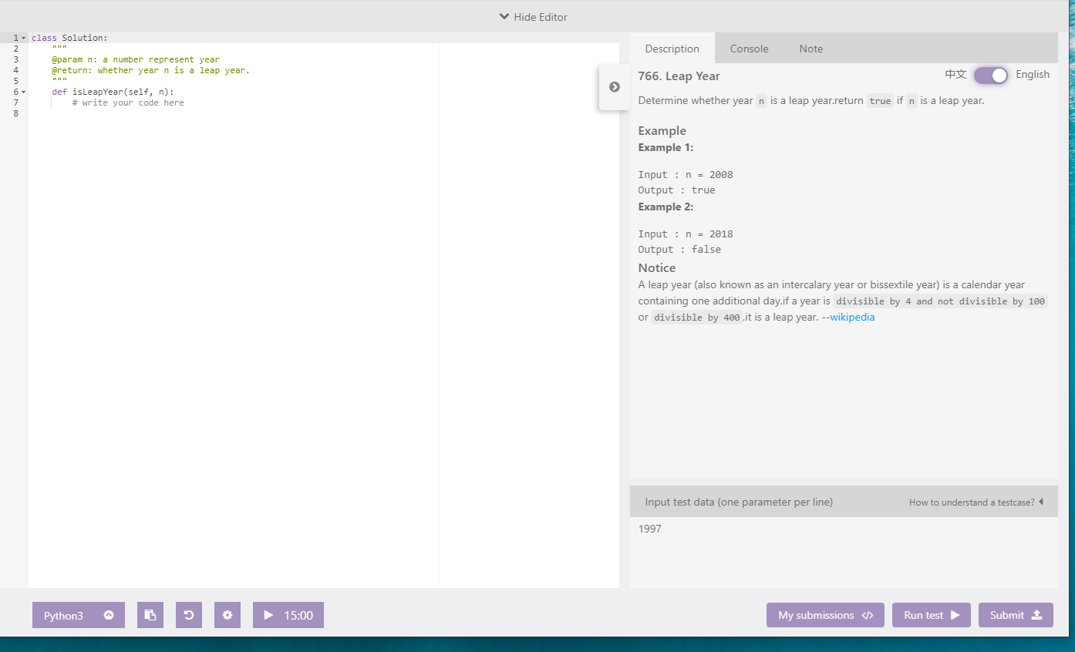
Practice on lintcode (sign up a free account)
www.lintcode.com https://www.lintcode.com/problem/a-b-problem/

Slide 6
Artificial Neural Networks Today
Where do we use this technology?

Slide 7
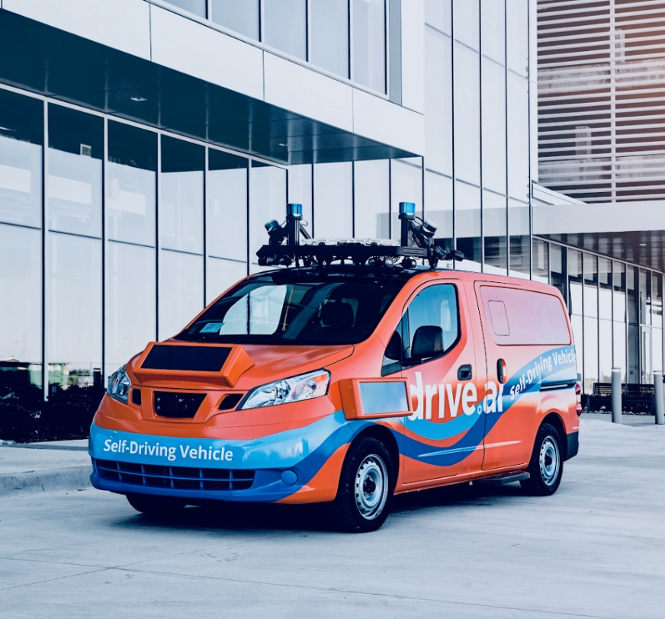
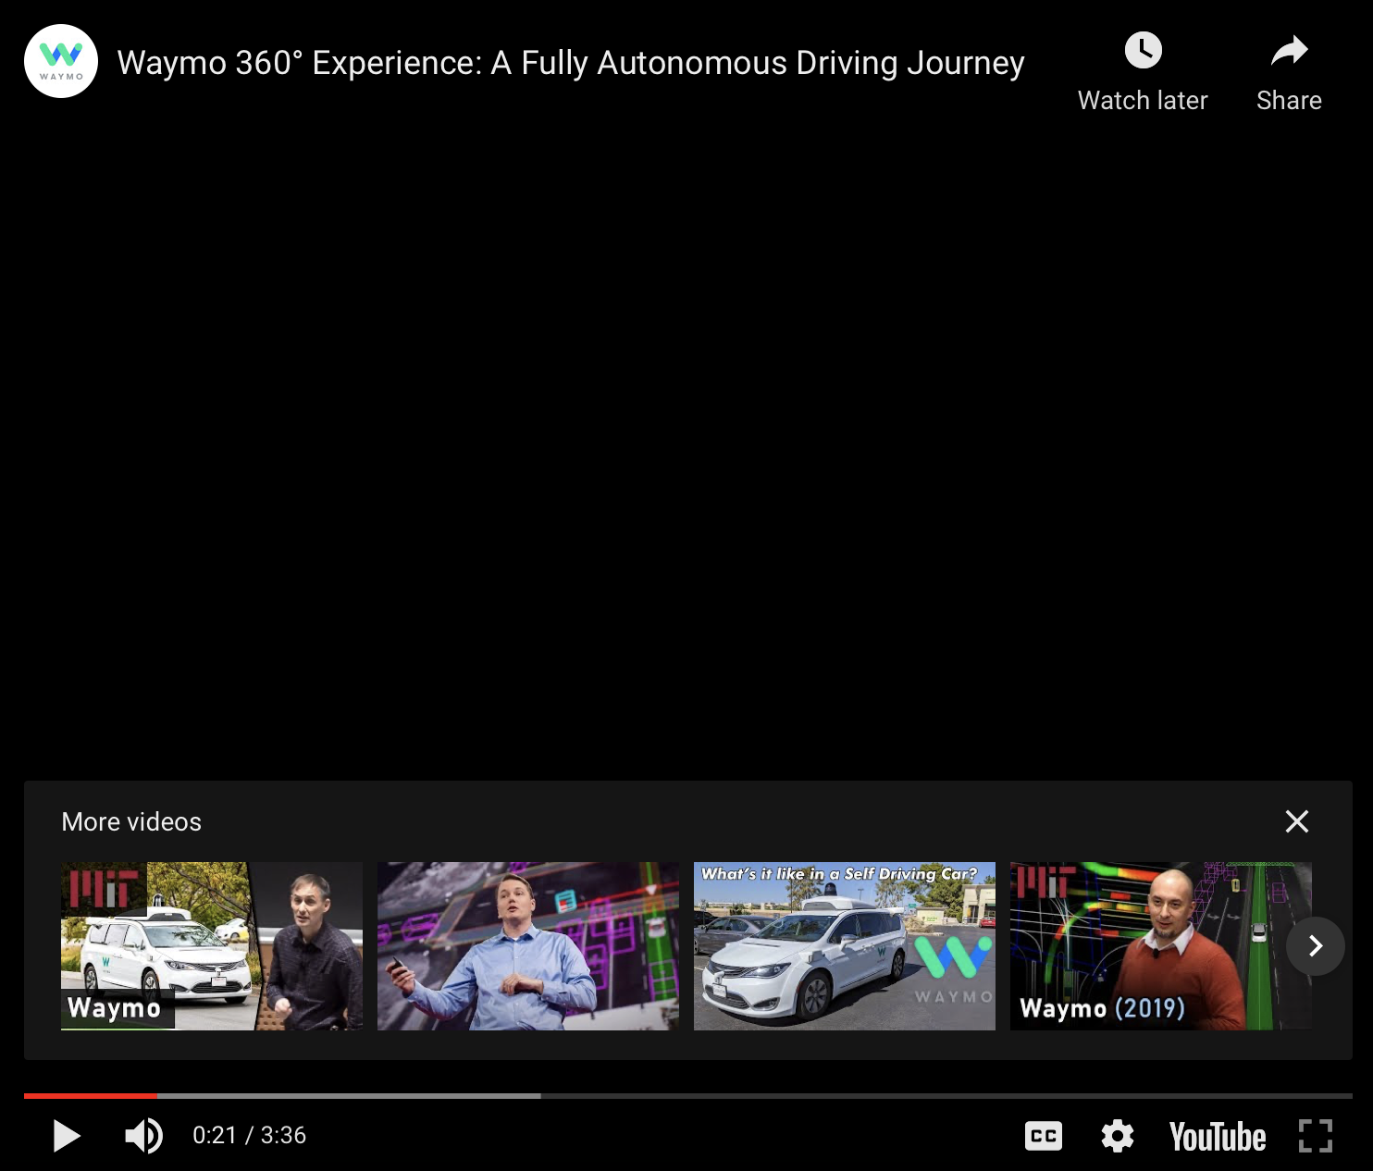
Artificial Neural Networks Today
AI Driving Cars
Self-driving vehicles are often powered by neural networks
Used to recognize objects on the road and to make decisions
https://medium.com/@andrewng/self-driving-cars-are-here-aea1752b1ad0
Link to video: https://www.youtube.com/watch?v=B8R148hFxPw

Slide 8
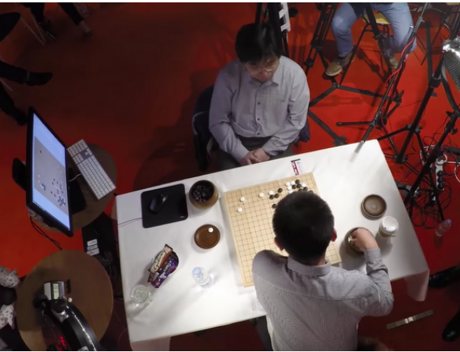
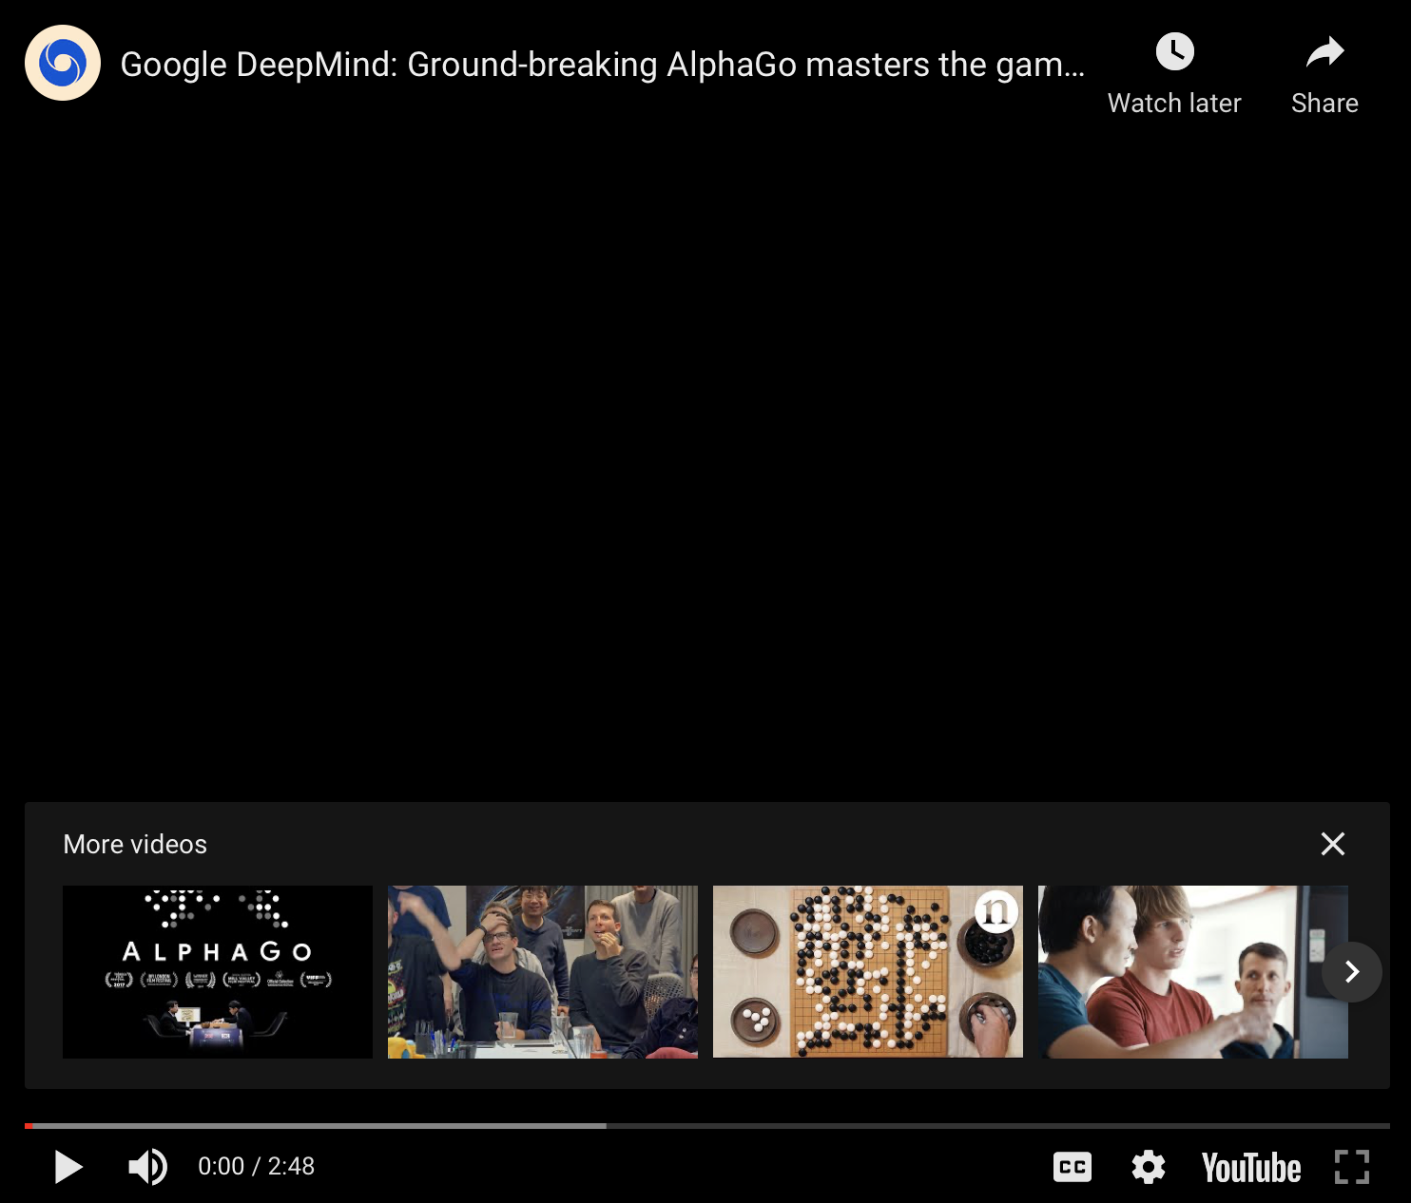
Artificial Neural Networks Today
AI Playing Go
Over a googol times as many board states as chess
Intuitive play
DeepMind defeated first ranked player Ke Jie in May 2017
https://blog.google/technology/ai/alphago-machine-learning-game-go/
Link to video: https://www.youtube.com/watch?v=SUbqykXVx0A

Slide 9
Artificial Neural Networks Today
Teach a network…
…to generate baby names
…or “Shakespeare”
DUKE VINCENTIO:
Well, your wit is in the care of side and that.
Second Lord:
They would be ruled after this chamber, and
my fair nues begun out of the fact, to be conveyed,
Whose noble souls I'll have the heart of the wars.
Clown:
Come, sir, I will make did behold your worship.
VIOLA:
I'll drink it.
Rudi
Levette
Berice
Lussa
Hany
Mareanne
Chrestina
Carissy
Marylen
Hammine
Janye
Marlise
Jacacrie
Hendred
Romand
Charienna
Nenotto
Ette
Dorane
Wallen
Marly
Darine
Salina
Elvyn
Ersia
Maralena
Minoria
Ellia
Charmin
Antley
Nerille
Chelon
Walmor
http://karpathy.github.io/2015/05/21/rnn-effectiveness/

Slide 10
Convolutional Neural Networks

Slide 11
Convolutional Neural Networks Applications
Photo Wake-Up
Link to video: https://youtu.be/G63goXc5MyU

Slide 12
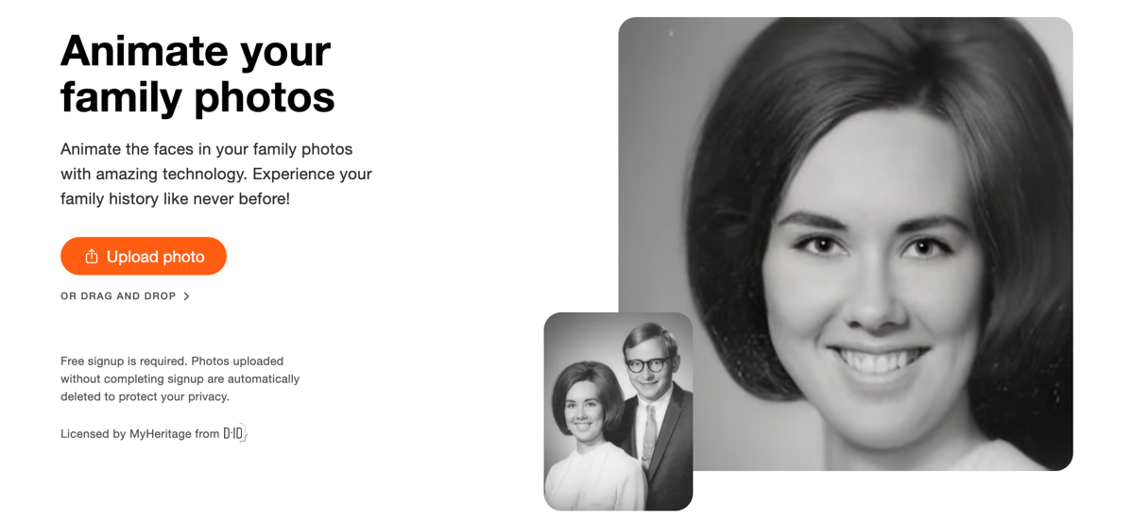
Convolutional Neural Networks Applications
Deep Nostalgia
By MyHeritage
Animates (old) photos
Went viral in February 2021
https://www.myheritage.com/deep-nostalgia
https://blog.myheritage.com/2021/02/deep-nostalgia-goes-viral/

Slide 13
Convolutional Neural Networks (Optional) Applications
Facial Recognition
Link to video: https://www.youtube.com/watch?v=vC3bTziLRTA

Slide 14
Natural language processing (NLP)

Slide 15
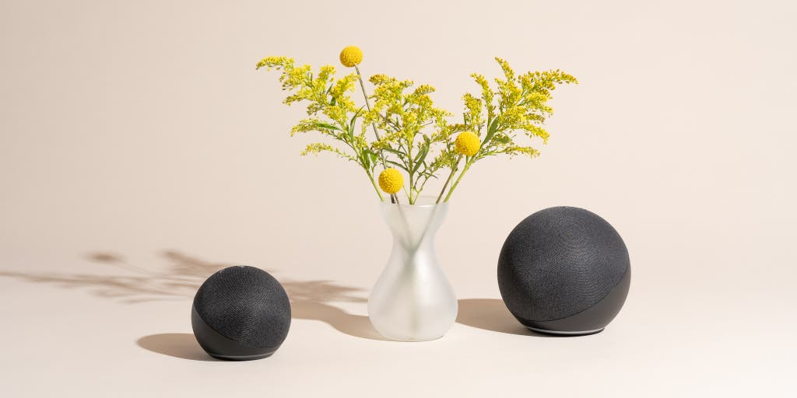
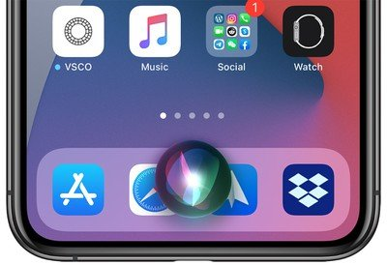
Amazon’s Alexa, Google’s Home, SIRI

Slide 16
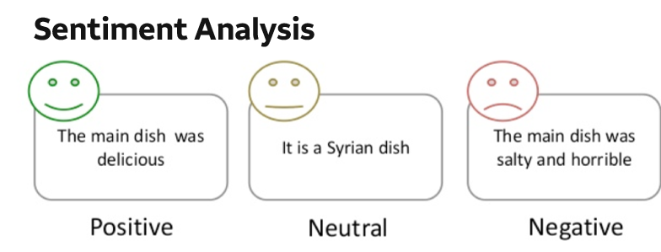

Slide 17
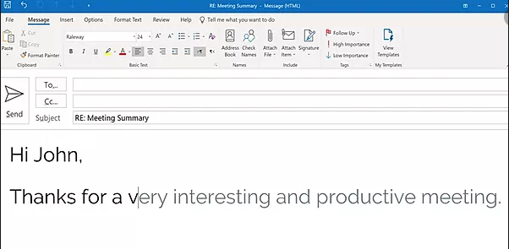
Speed up word processing and facilitate text dictation

Slide 18
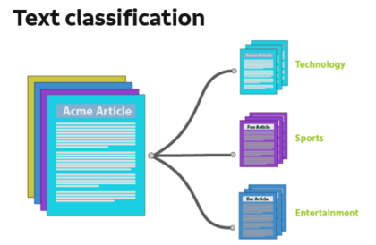
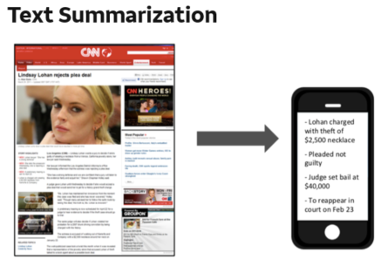

Slide 19
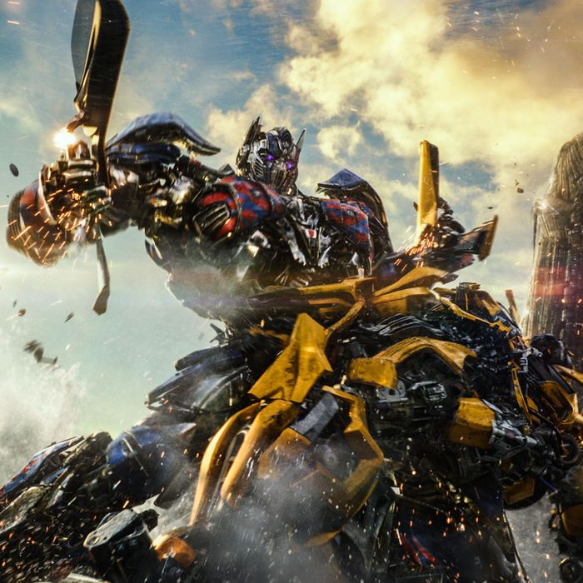
Transformer
Introduction (optional)
https://www.youtube.com/watch?v=4Bdc55j80l8&t=135s

Slide 20
Reinforcement learning

Slide 21
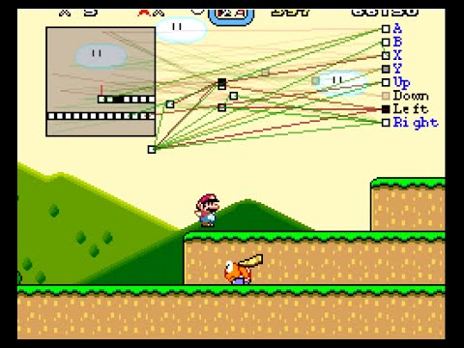
MarI/O

Slide 22
GAN

Slide 23
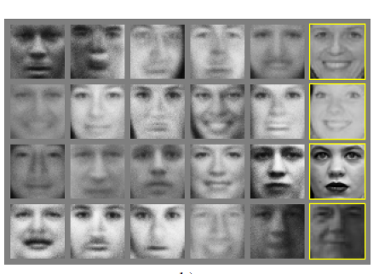
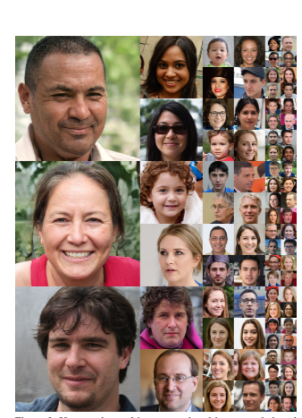
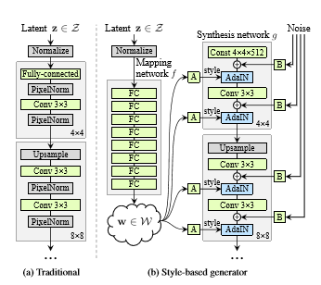
Application on Image Data
GAN 1.0
GAN 2.0: This person does not exits by GAN 2.0:
https://www.thispersondoesnotexist.com/

Slide 24
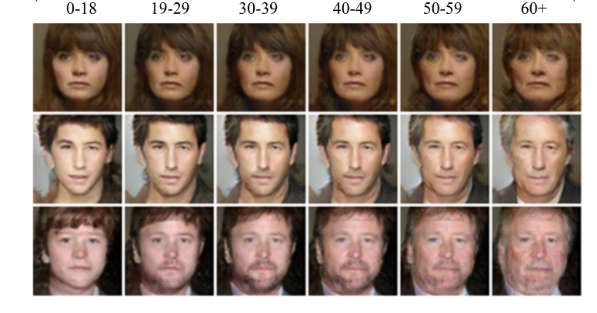
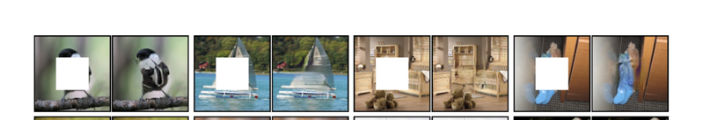
Application on Image Data
Face aging
Image painting

Slide 25
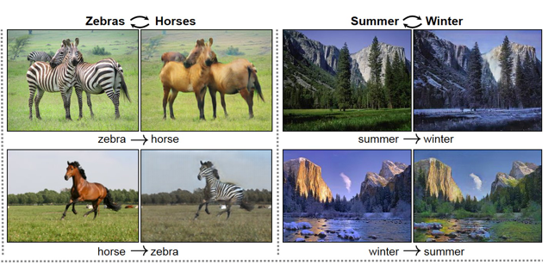
Application on Image Data
Cycle GAN: transform pictures between zebras and horses, and changing of seasons.

Slide 26
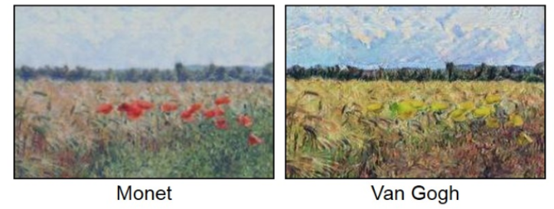
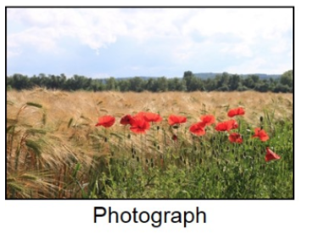
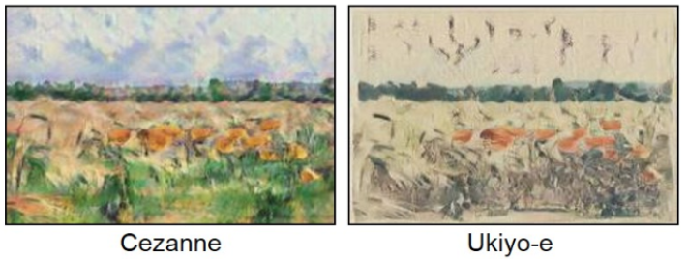
Application on Image Data
Cycle GAN

Slide 27
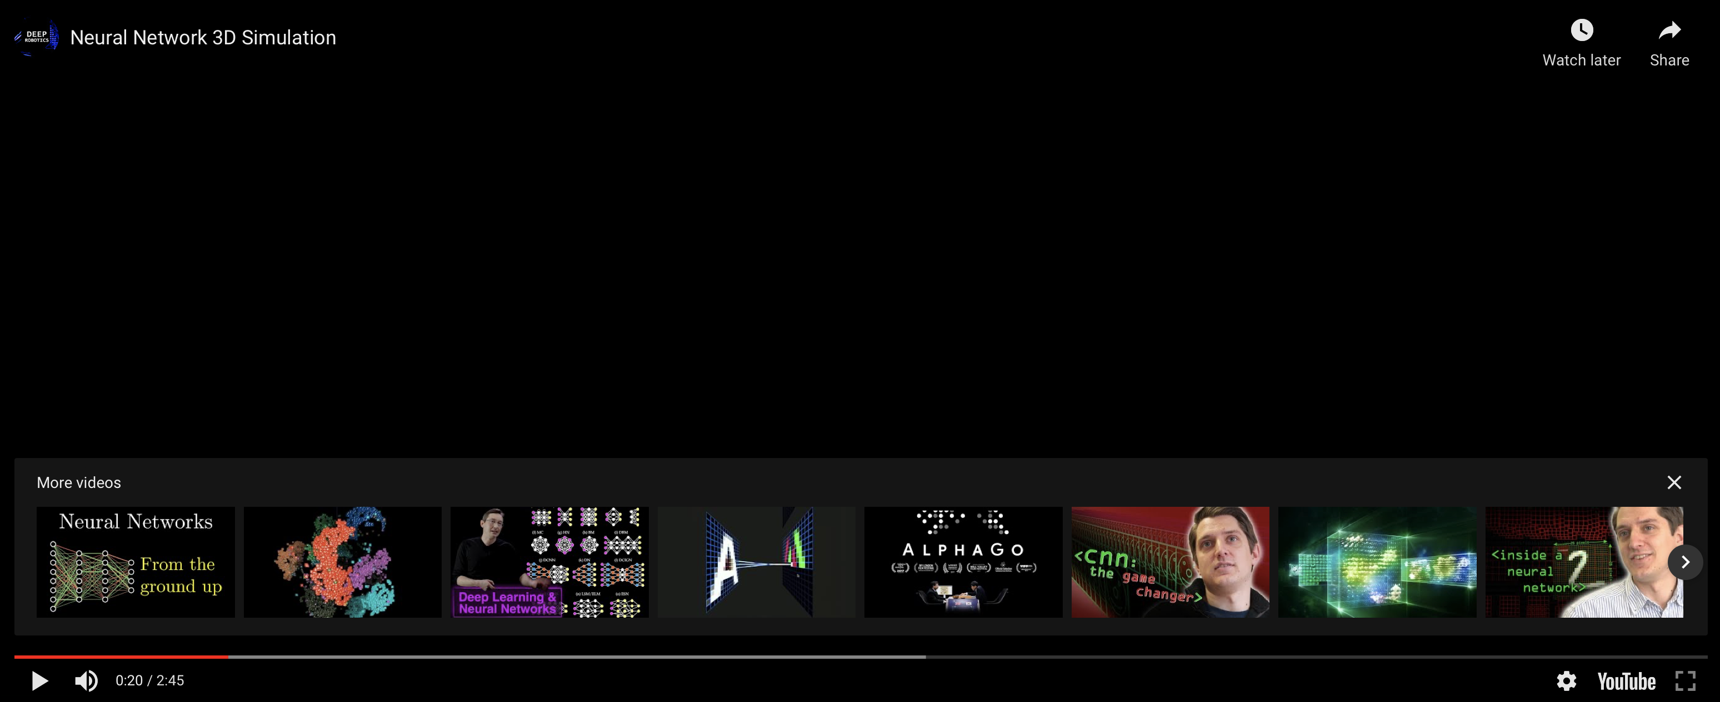
Neural Network Simulation
Link to video: https://www.youtube.com/watch?v=3JQ3hYko51Y

Slide 28
AI Startup Team Project
Neural Network Team Task

Slide 29
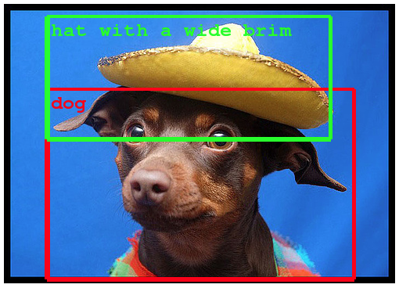
Neural Network Team Task
Object Recognition
Learn to recognize objects in complicated images, videos, or even video games
https://ai.googleblog.com/2014/09/building-deeper-understanding-of-images.html

Slide 30
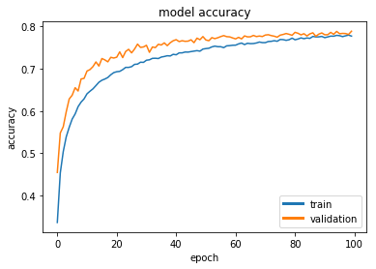
Neural Network Team Task
Team Task: build a Neural Network Model (NN) to recognize objects in images
Training Data and the basic structure of the NN model are provided
Students need to try different model parameters and settings in order to have the best model performance
Assessment of performance: accuracy on testing data set

Slide 31
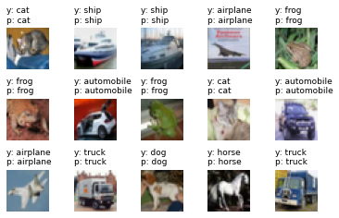
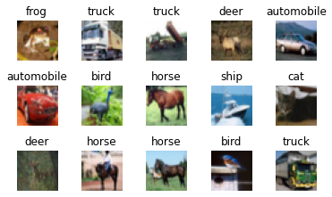
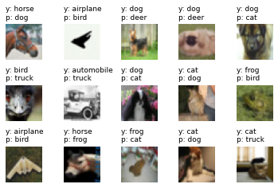
Neural Network Team Task

Slide 32
Platform Set-up (Google Colab)
log out all of your google accounts (google drive , gmail, etc.) and log into one personal google account for this camp in google drive (drive.google.com)
Download Mounting_Drive_and_Cloning_Repository.ipynb from https://github.com/DSAISummerCamp/dscamp_public/tree/master/Colab_Setup
Save it in your google drive.
Select 'Mounting_Drive_and_Cloning_Repository.ipynb' file in google drive and open in Colab.
Run the cells in the notebook, following the directions. This should mount your Google Drive, and clone the rest of this repository into your drive, making all the camp materials easily accessible.
Log on to https://drive.google.com. You should see a new folder called dscamp, and within that folder should be a copy of this repository.
You can open any of the notebooks in the folder by Right Click -> Open With... -> Google Colabratory. You may need to click "OK" to connect to Colab the first time.

Slide 33
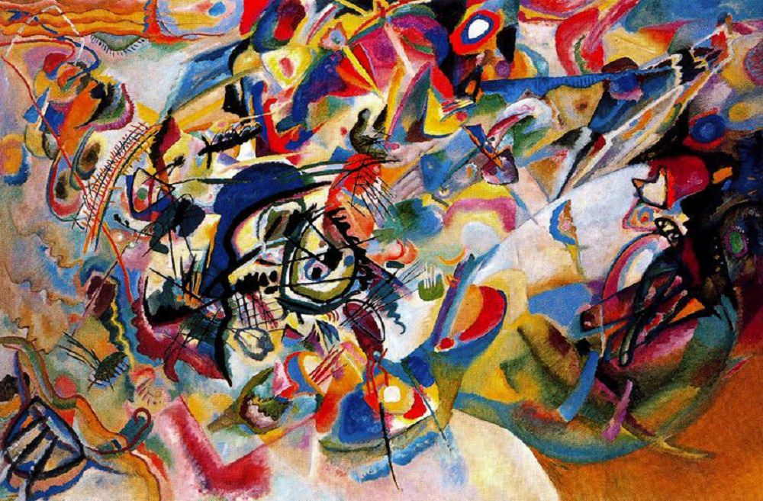
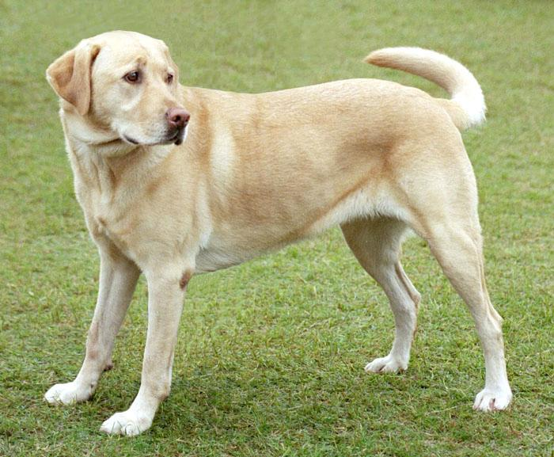
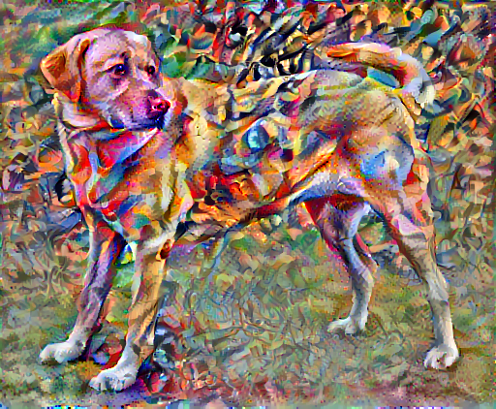
Style Transfer Example (optional)
+
=
Open: style_transfer.ipynb in google colab
Run all

